Slide 1



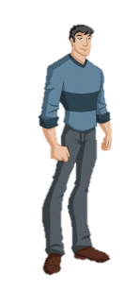


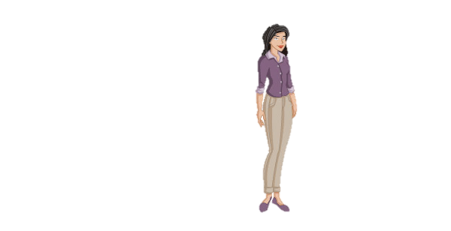


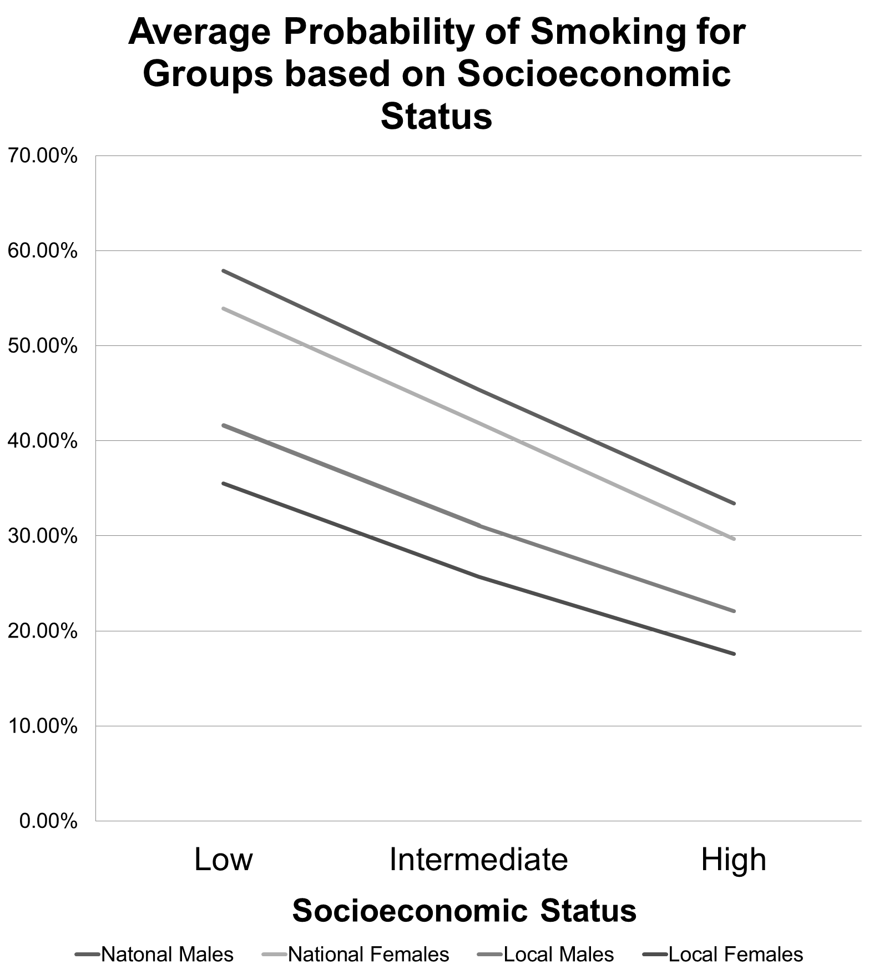
The Prevalence and Intensity of Tobacco Use among Youth: Worcester, MA
Samantha Arsenault
Thesis Advisor: Dr. John Brown
Abstract
In the city of Worcester, MA lung cancer is the leading cause of cancer related deaths (City of Worcester, 2014). Not only is smoking the leading cause of lung cancer, the 2014 Surgeon General’s report causally linked smoking to 14 other types of cancer and over 20 chronic diseases. As most smokers begin smoking in their teens, the Worcester Division of Public Health (DPH) and community partners within the Central Massachusetts Regional Public Health Alliance have prioritized reducing the rate of high school students that smoke by the year 2020 as a distinct goal of the Community Health Improvement Plan. This study helps to understand high-risk groups for tobacco use through an economic analysis and informs future prevention efforts to help achieve the goal of reducing tobacco use among high school students in Worcester, MA.
Data
Tobacco consumption among high school students in the Worcester region was studied using data from the Regional Youth Health Survey (RYHS) that was conducted in the 2013-2014 academic school year. The survey was conducted in Grafton, Shrewsbury, Leicester, Millbury, and Worcester Public High Schools, as well as the Diocese of Worcester. In total, 8,703 high school students from the region completed the survey. The survey provides demographic information as well as health and risk related information beyond that of tobacco use. For the purpose of comparing trends in the region to national trends data from the 2009 National Survey on Drug Use and Health (NSDUH) was used. The NSDUH includes a sample from each of the 50 states and the District of Colombia, when observations are restricted by age (13-19) and by education (current high school students), 7,990 observations remain.
Methods
Probit and bivariate probit models were used to understand the prevalence of tobacco use among high school students. These models were chosen to suit the use of a bivariate dependent variable. Tobit and ordered probit models were used to understand the intensity of tobacco use, as measured by the number of days smoked. These models were chosen to suit the categorical nature of the dependent variable.
Results
High risk groups were identified based on three categories, demographics, socioeconomic status, and behavior. The study found that in the Worcester region White and Hispanic Males have the highest risk of smoking based on demographics. The risk of tobacco use increases as grade and age increases, with a jump in use from 10th to 11th grades. Based on socioeconomic status, lower socioeconomic status increases tobacco use for all groups. Based on behavior, risk seeking individuals have a higher risk of tobacco use than risk averse individuals.
Race/ Ethnicity: Gender Grade: *Socioeconomic Status is controlled for, all individuals have low socioeconomic Status | Hispanic Male 11th | White Female 10th | Black Male 9th | Other Race Female 9th | White Male 12th | Hispanic Female 12th
Local Probability | 48.23% | 33.6% | 34.8% | 28.8% | 47.6% | 43.4%
National Probability | 66.46% | 59.6% | 54.65% | 44.5% | 70.58% | 65.3%
Demographic, Socioeconomic, and Risk Seeking Behavior Factors on Smoking Prevalence
VARIABLES | Ever Smoked (National) | Ever Smoked (Local)
 | (1) | (2)
Male | 0.0218* | 0.0435***
Black | -0.182*** | -0.0434***
Hispanic | -0.0243 | -0.00366
Other Race | -0.0581** | -0.0137
Moved | 0.176*** | 0.0964***
Job | 0.119*** | 0.110***
Risk Seeker | 0.195*** | 0.182***
Observations | 7,991 | 8,695
Table based on predicted probability of probit estimation: Pr(Ever Smoked = 1) = Φ (β₀ + β₁ Male + β₂ Black + β₃ Hispanic + β₄ Other Race + β₅ Moved + β₆ Job + β₇ Grade)
1.1 Demographics
Understanding variations in tobacco use based on demographic factors informs public health professionals and policy makers of possible high risk groups which can be targeted through interventions. This study sought to examine whether gender, race/ ethnicity, grade, and age effect the prevalence and intensity of tobacco use among high school students, and to compare the trends in demographics and tobacco use between the Worcester region and a national sample.
Gender
All of the estimations for each product of interest (cigarettes, cigars, and chewing tobacco) , on both the local and national samples, revealed that males have both a higher prevalence and intensity of use than females. When socioeconomic status, age, and race/ethnicity were controlled for, males in the Worcester region were 4.64% (p<0.01) more likely to have ever smoked cigarettes than females. Both tobit and ordered probit models measuring smoking intensity also revealed that males in both the Worcester region and nationally have a higher probability of being intense smokers (p<0.01) as measured by the number of days smoked.
Race / Ethnicity
In both the local and national samples individuals identifying as Black have the lowest probability of smoking. However, in the national sample Blacks are 16.7% (p<0.01) less likely to smoke than Whites, and in the local sample Blacks are just 2.6% (p<0.05) less likely to smoke than whites when gender, socioeconomic status, and age are controlled for. In the Worcester region Hispanics have the highest probability of tobacco use based on race, just slightly higher than Whites. Nationally, Whites have the highest probability of smoking. Estimations on the variable Other Race (including individuals that self-identify as American Indian/ Native American, Eskimo, Aleut, Asian, Pacific Islander, or Other) was imprecise.
Grade & Age
The models for prevalence and intensity consistently revealed that both increase with age and with grade. The estimations on grade revealed a change from 10th to 11th grade drastically increases smoking prevalence and informs us that tobacco interventions should occur before leaving 10th grade.
Sources: Results of probit estimations on National Survey on Drug Use and Health (2009) and Regional Youth Health Survey (2013-2014)
Notes: *** p<0.01, ** p<0.05, * p<0.1, Marginal effects are shown instead of coefficients. Dependent variable Ever Smoked = 1 if an individual has ever smoked, 0 if they have not. Other Race incudes individuals that self-identify as American Indian/ Native American, Eskimo, Aleut, Asian, Pacific Islander, or Other. Female is the gender base group, and White is the racial/ ethnic base group. Moved and Job are socioeconomic indicators, low socioeconomic status is classified by both variables equaling 1. Risk Seeker is equal to one for individuals that indicated that they do not always wear their seatbelt when they are riding in a car, this variable is used as a proxy for risky-behavior.
1.2 Socioeconomic Status
Studies across disciplines and in different regions of the world have examined the effect of socioeconomic status on tobacco use and found that low socioeconomic status is related to higher tobacco use. This is consistent with general health inequities that correlate with socioeconomic status. Understanding whether these trends exist in the Worcester region and their extent is essential for tobacco intervention and prevention efforts.
Socioeconomic Status and Smoking Prevalence
Two variables were used to capture socioeconomic status, whether the student has moved in the last year, and whether they have held a part time job. In a probit model on the local data where gender, race, and age were controlled for the combined low socioeconomic status indicators resulted in an individual being 17.5% (p<0.01) more likely to have smoked. On the national level, individuals with low socioeconomic status were 20% (p<0.01) more likely to have smoked. Based on the estimations, it was found that increasing socioeconomic status will always decrease the probability of smoking.
Socioeconomic Status and Smoking Intensity
The effect of socioeconomic status on smoking intensity, as measured by the average number of days smoked per month was also tested. An ordered probit model, with a categorical dependent variable for the number of days smoked was run on both the local and national data. When the marginal effects of the model were calculated low socioeconomic individuals in the Worcester region were 10% (p<0.01) less likely to smoke zero days, and 4.2% (p<0.01) more likely to smoke all 30 days than high socioeconomic status individuals.
Low Socioeconomic Status = High Risk Tobacco Users
The positive link between socioeconomic status and tobacco use was also shown in bivariate probit estimations which examined other tobacco products (cigars and chewing tobacco), showing that overall, low socioeconomic status increases the risk of tobacco use.
1.3 Risk Seeking Behavior
The addition of a variable for risk seeking behavior to the model aids in understanding the effects between socioeconomic status and smoking prevalence by adding risk seeking behavior as a channel for increased tobacco consumption. This allows for exploration of whether the relationship between socioeconomic status and tobacco consumption is due to a shortfall of information among lower socioeconomic sub-populations or an overall riskier lifestyle among these groups.
The variable Risk Seeker is a dummy variable equal to one if the individual reported not always wearing their seatbelt when riding in a car. Unlike other studies which have measured risk perception and tobacco use, this variable is able to capture behavioral aspects previously not studied in the literature. This also avoids the issue that risk averse individuals may perceive risk differently than risk seeking individuals.
Risk Seeker was added to the model and was interacted with socioeconomic status, however, the estimations reveal that individuals with low socioeconomic status are not more likely to engage in risky behavior in general, but instead that both low socioeconomic individuals and risk seeking individuals have higher probabilities of smoking. Meaning that there are individuals, regardless of socioeconomic status, who are risk seeking in general and who we can precisely predict are more likely to smoke.
Risk Seeking Behavior and Smoking Prevalence
When socioeconomic status, race, and gender were controlled for, risk seeking individuals in the Worcester region were 18.2% (p<0.01) more likely to have ever smoked, and nationally were 19.5% (p<0.01) more likely to have ever smoked.
Risk Seeking Behavior and Smoking Intensity
Ordered probit models on both local and national data which controlled for gender, race, and socioeconomic status showed that risk seeking individuals were significantly more likely (p<0.01) to smoke more days per month than risk averse individuals.
These findings show the need for public health interventions which aim not only to educate individuals on the dangers of smoking, but also to prevent risk-seeking behavior in general.
Conclusion
This econometric analysis of tobacco use on local and national levels reveals that similar trends exist in Worcester as the United States as a whole, with minor variations in the magnitudes of the relationships. This study reveals that certain high risk groups should be targeted for tobacco prevention efforts.
Demographics
In the Worcester region White and Hispanic males are the highest risk group by demographic subpopulation. While universal interventions should still be a part of high school curriculum these groups experience the highest prevalence and intensity of use. There is also a jump in the probability of trying tobacco products after grade 10, showing that prevention efforts should occur before this year.
Socioeconomic Status
Low socioeconomic status individuals are a high risk subpopulation for tobacco use. Prevention efforts and public health interventions should consider this. Future research on tobacco use among high school students should consider the percent of students on free or reduced lunch as an indicator of socioeconomic status, as well as examining data on household size.
Risk Seeking Behavior
Risk seeking individuals have a significantly higher prevalence and intensity of tobacco use than risk averse individuals. Therefore, conventional prevention efforts which educate individuals on the known risks of tobacco use may not decrease use among this risk seeking group. Instead, interventions should focus on decreasing overall risk seeking behavior, possibly through increasing perceptions of self worth. This should be explored in future research, as well as other possible channels, such as mental illness, self esteem, and social capital.

